Slide 1
Derby air pollution analysis
Analysed by Alex Large (Junior Data Analyst) as a furlough project
Sharing graphs on Instagram at @derbyairpollution
My email: alexanderklarge@gmail.com
Data from: https://uk-air.defra.gov.uk/data/flat_files?site_id=DESA
Analysed with Python coding language
Code visible here: https://github.com/productivityboyz/Air-Pollution-Project (main file = Alex’s Air Pollution Analysis.ipynb)

Slide 2
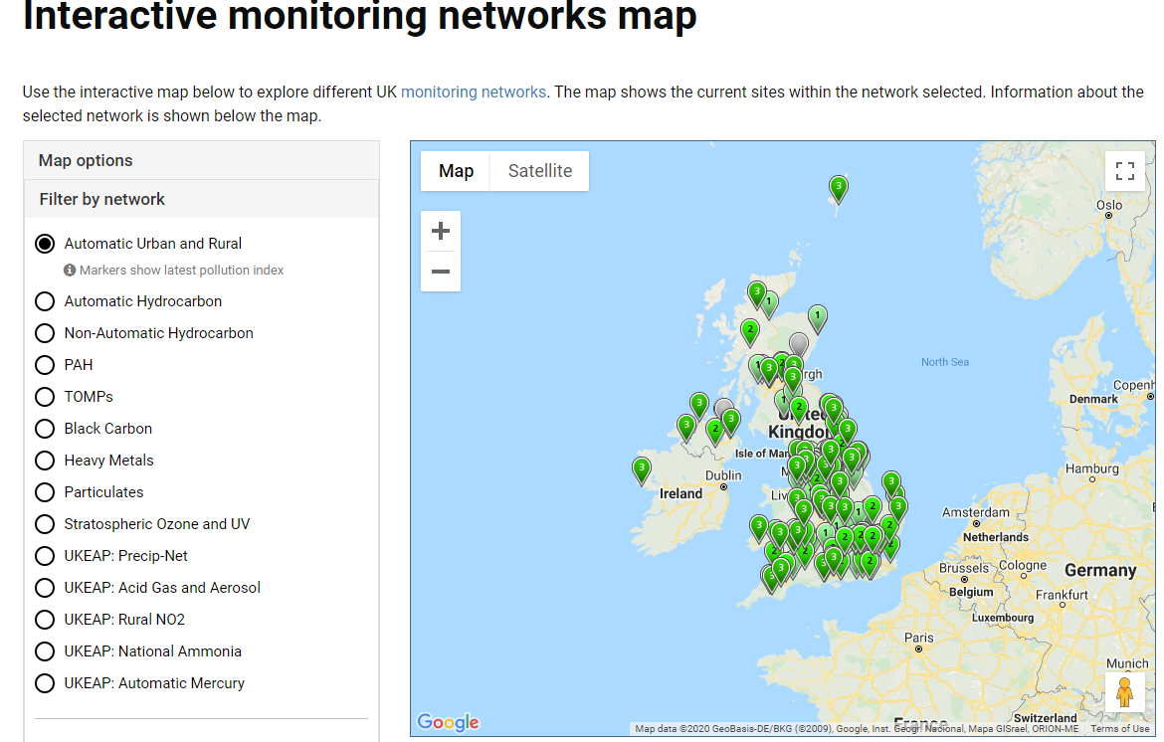
https://uk-air.defra.gov.uk/interactive-map

Slide 3
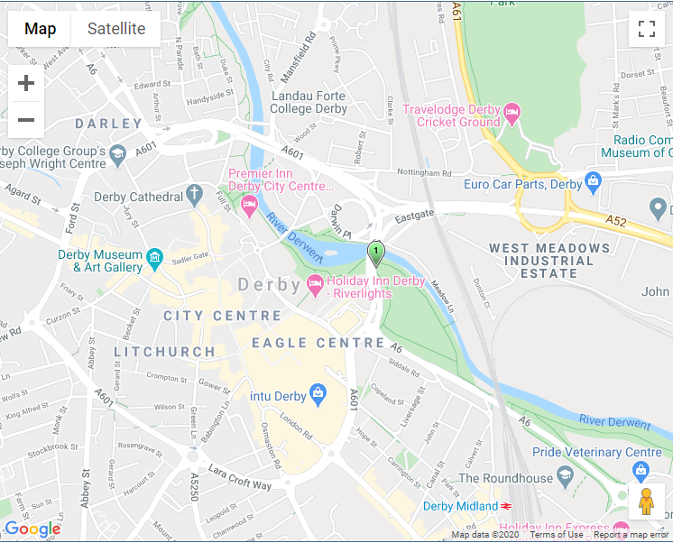
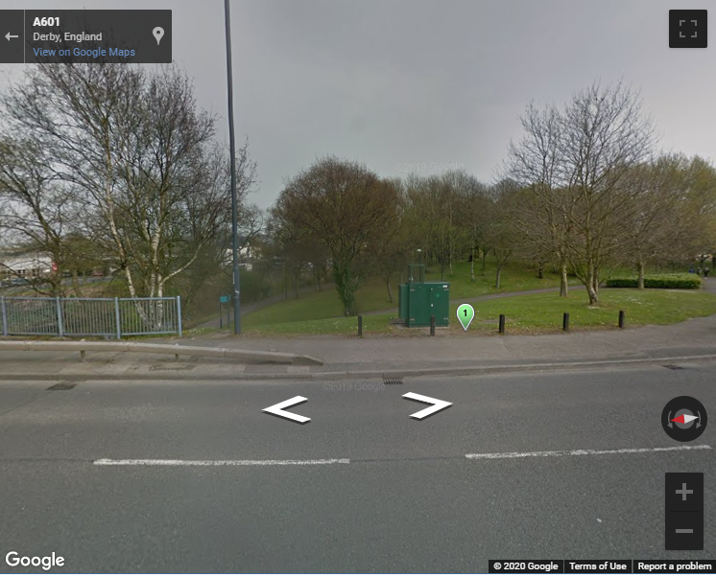

Slide 4
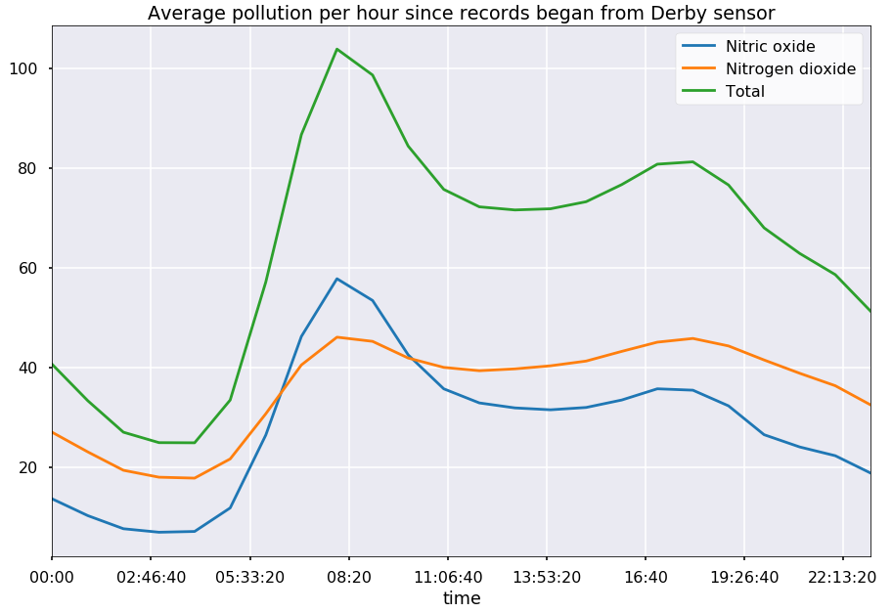
Pollution over a day

Slide 5
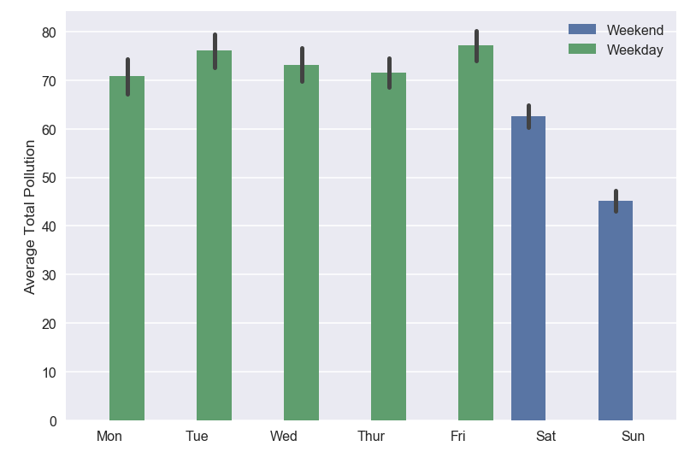
Pollution across weekdays

Slide 6
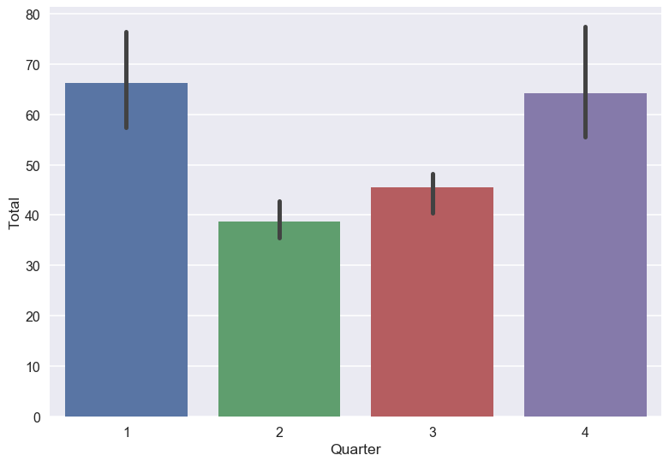
Pollution across quarters

Slide 7
2020 weekly pollution vs previous years

Slide 8
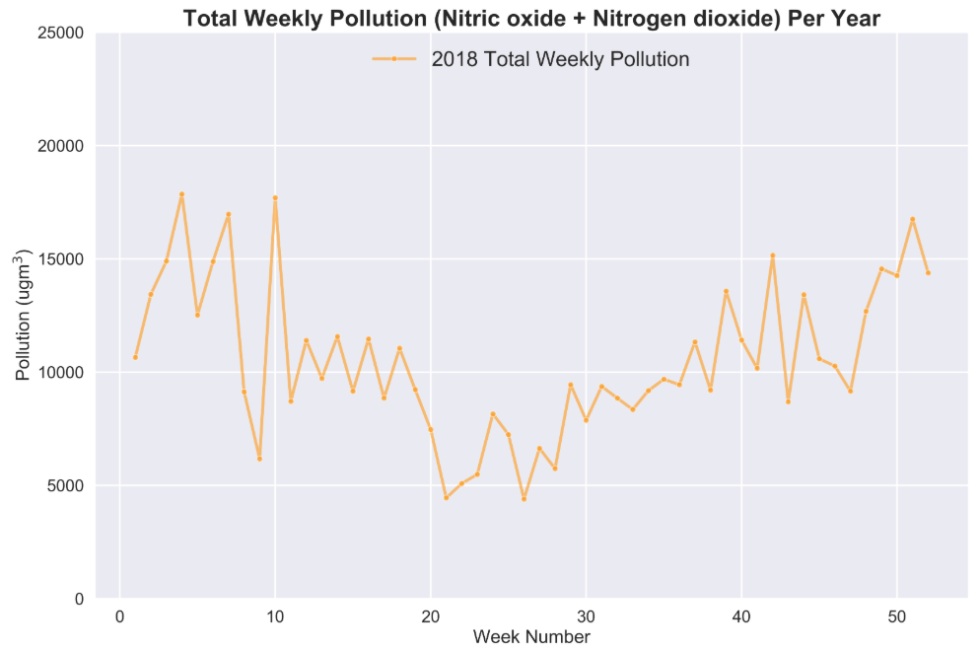

Slide 9
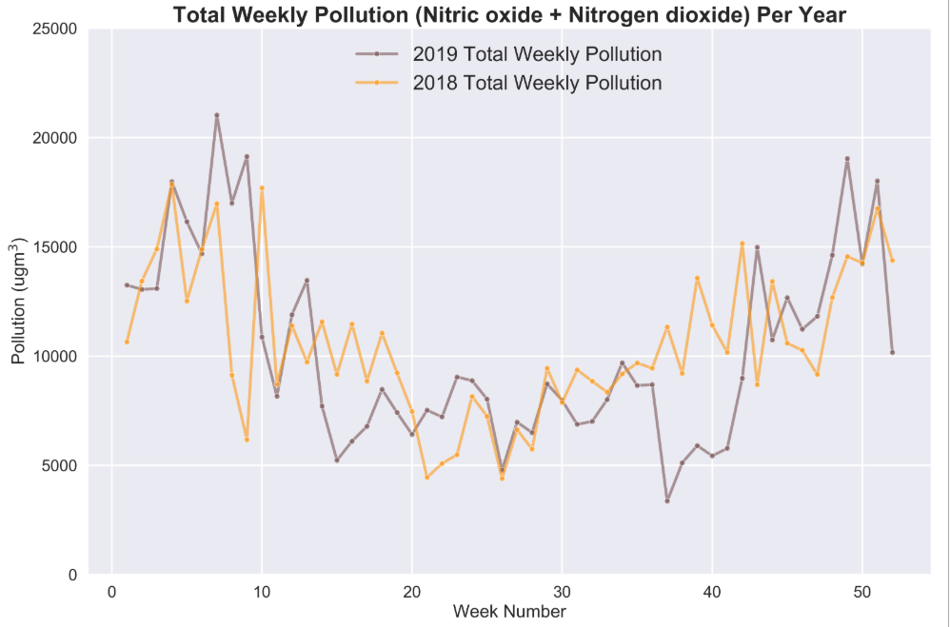

Slide 10
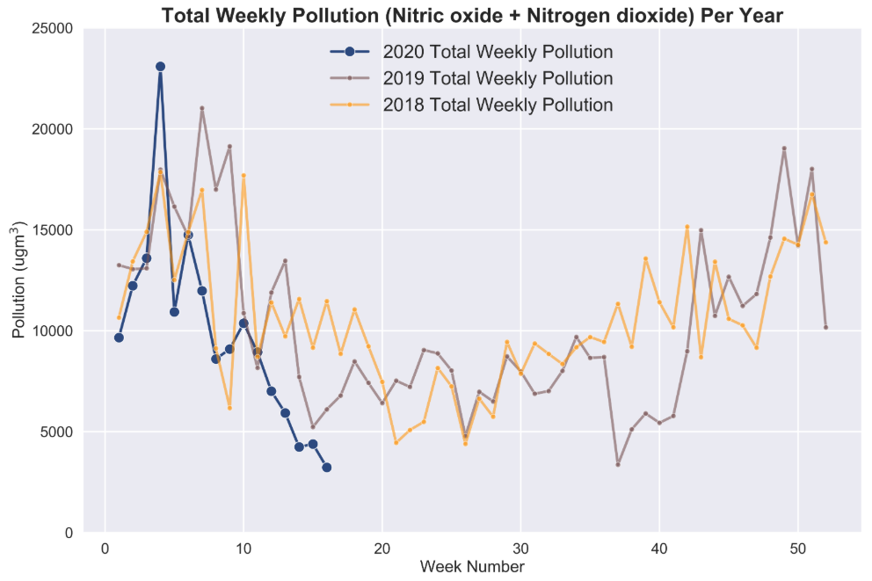

Slide 11
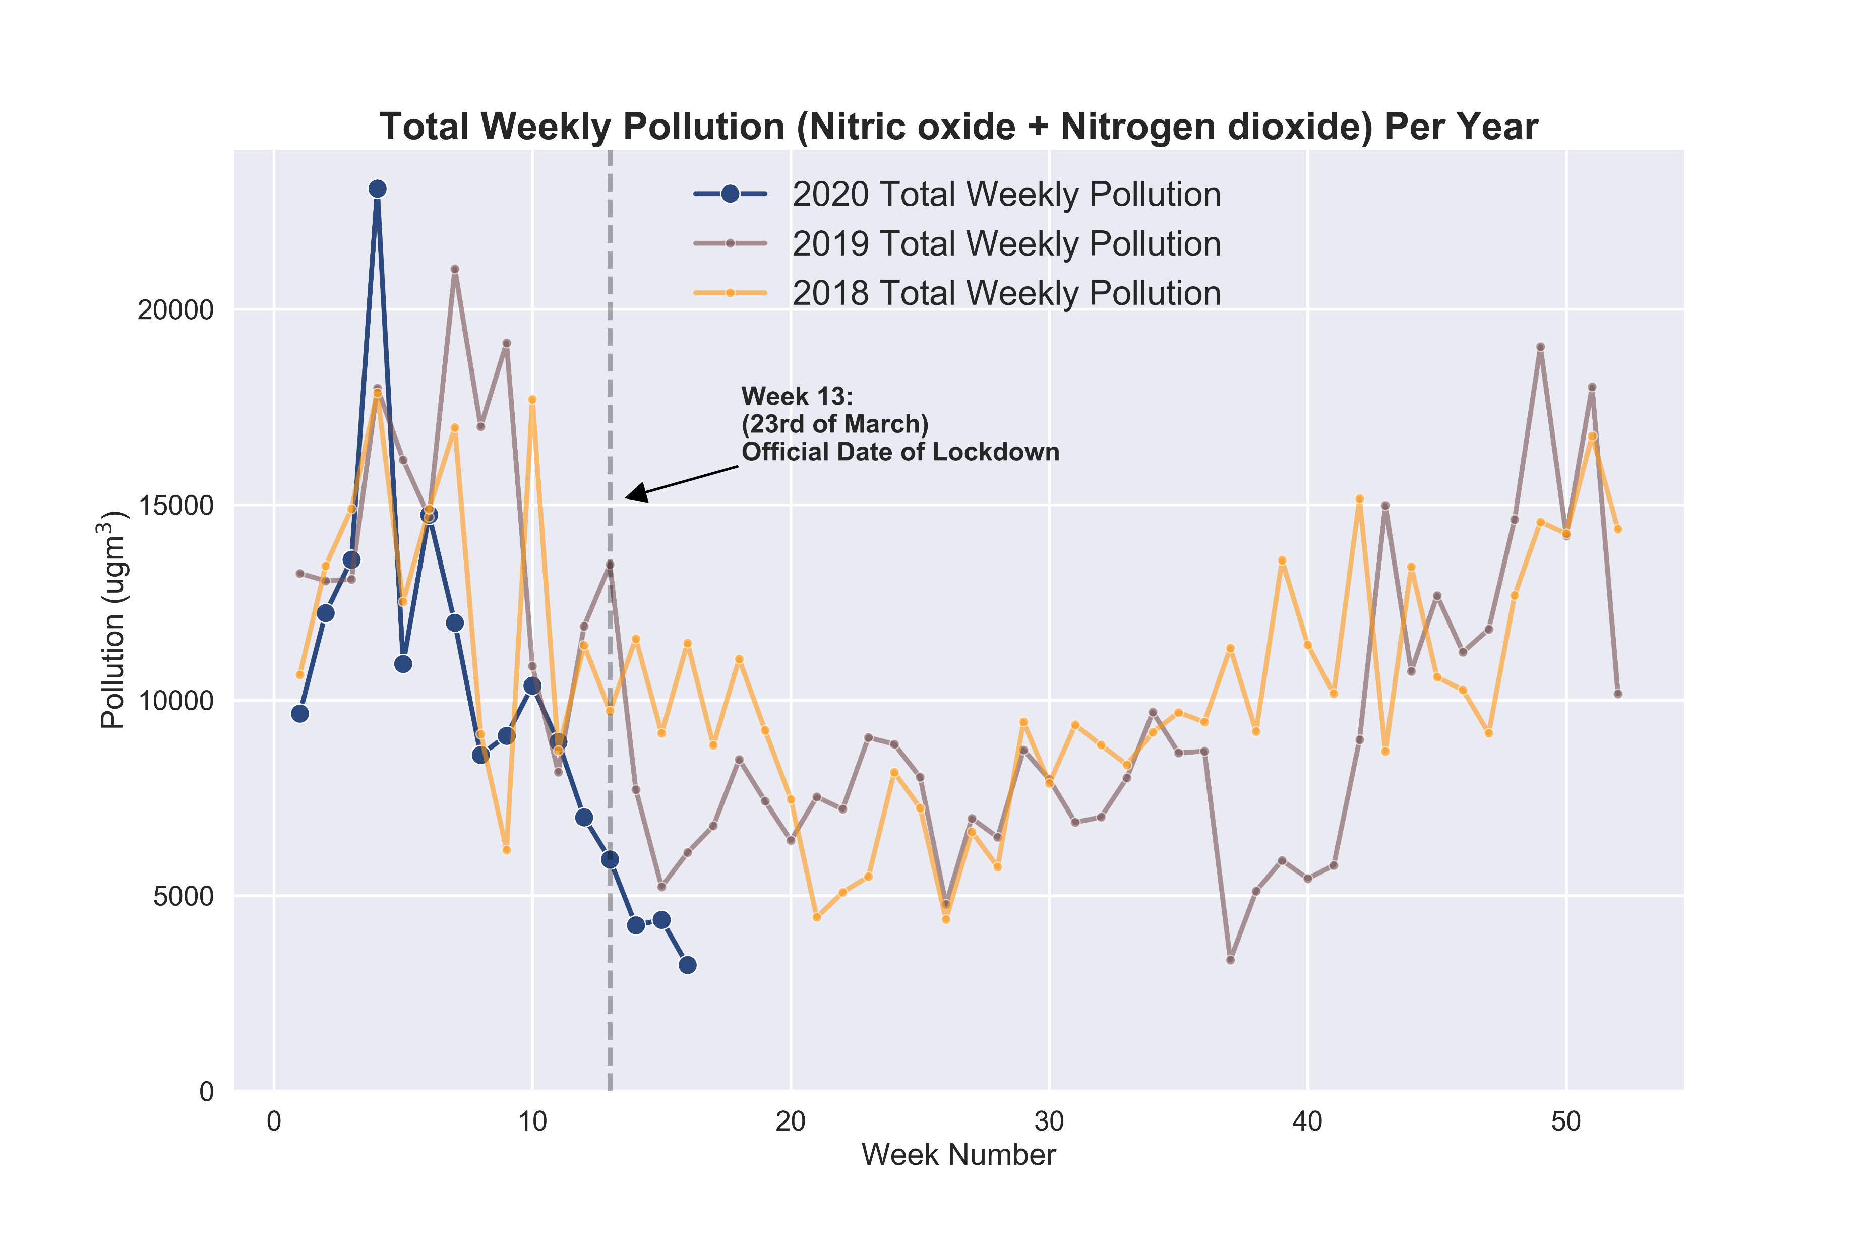
2020 compared to 2019 and 2018
Notes:
Commentary: note that pollution is clearly high in Q1 and Q4 and drops in Q2 and Q3

Slide 12
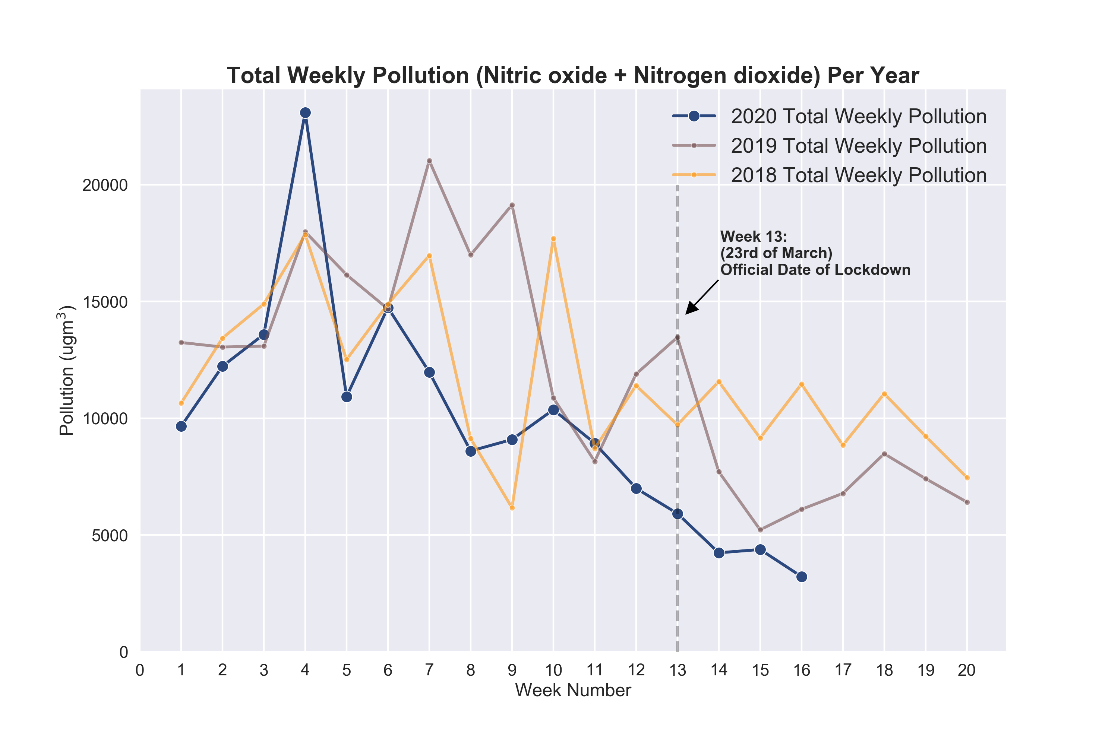
Previous graph but zoomed in

Slide 13
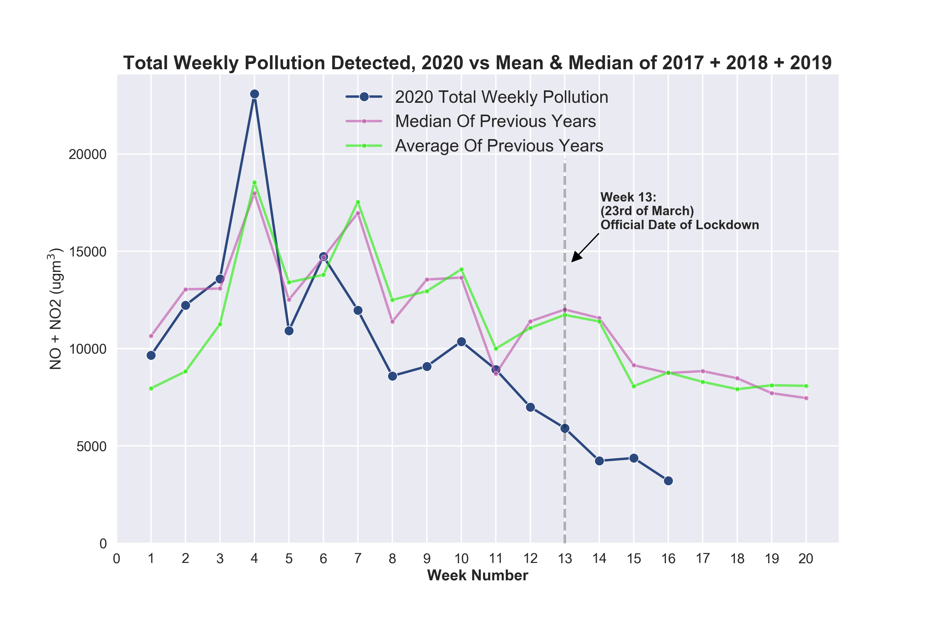
Comparing 2020 to median and mean of 2017 + 2018 + 2019 for a better idea of how this year is comparing to “normal”

Slide 14
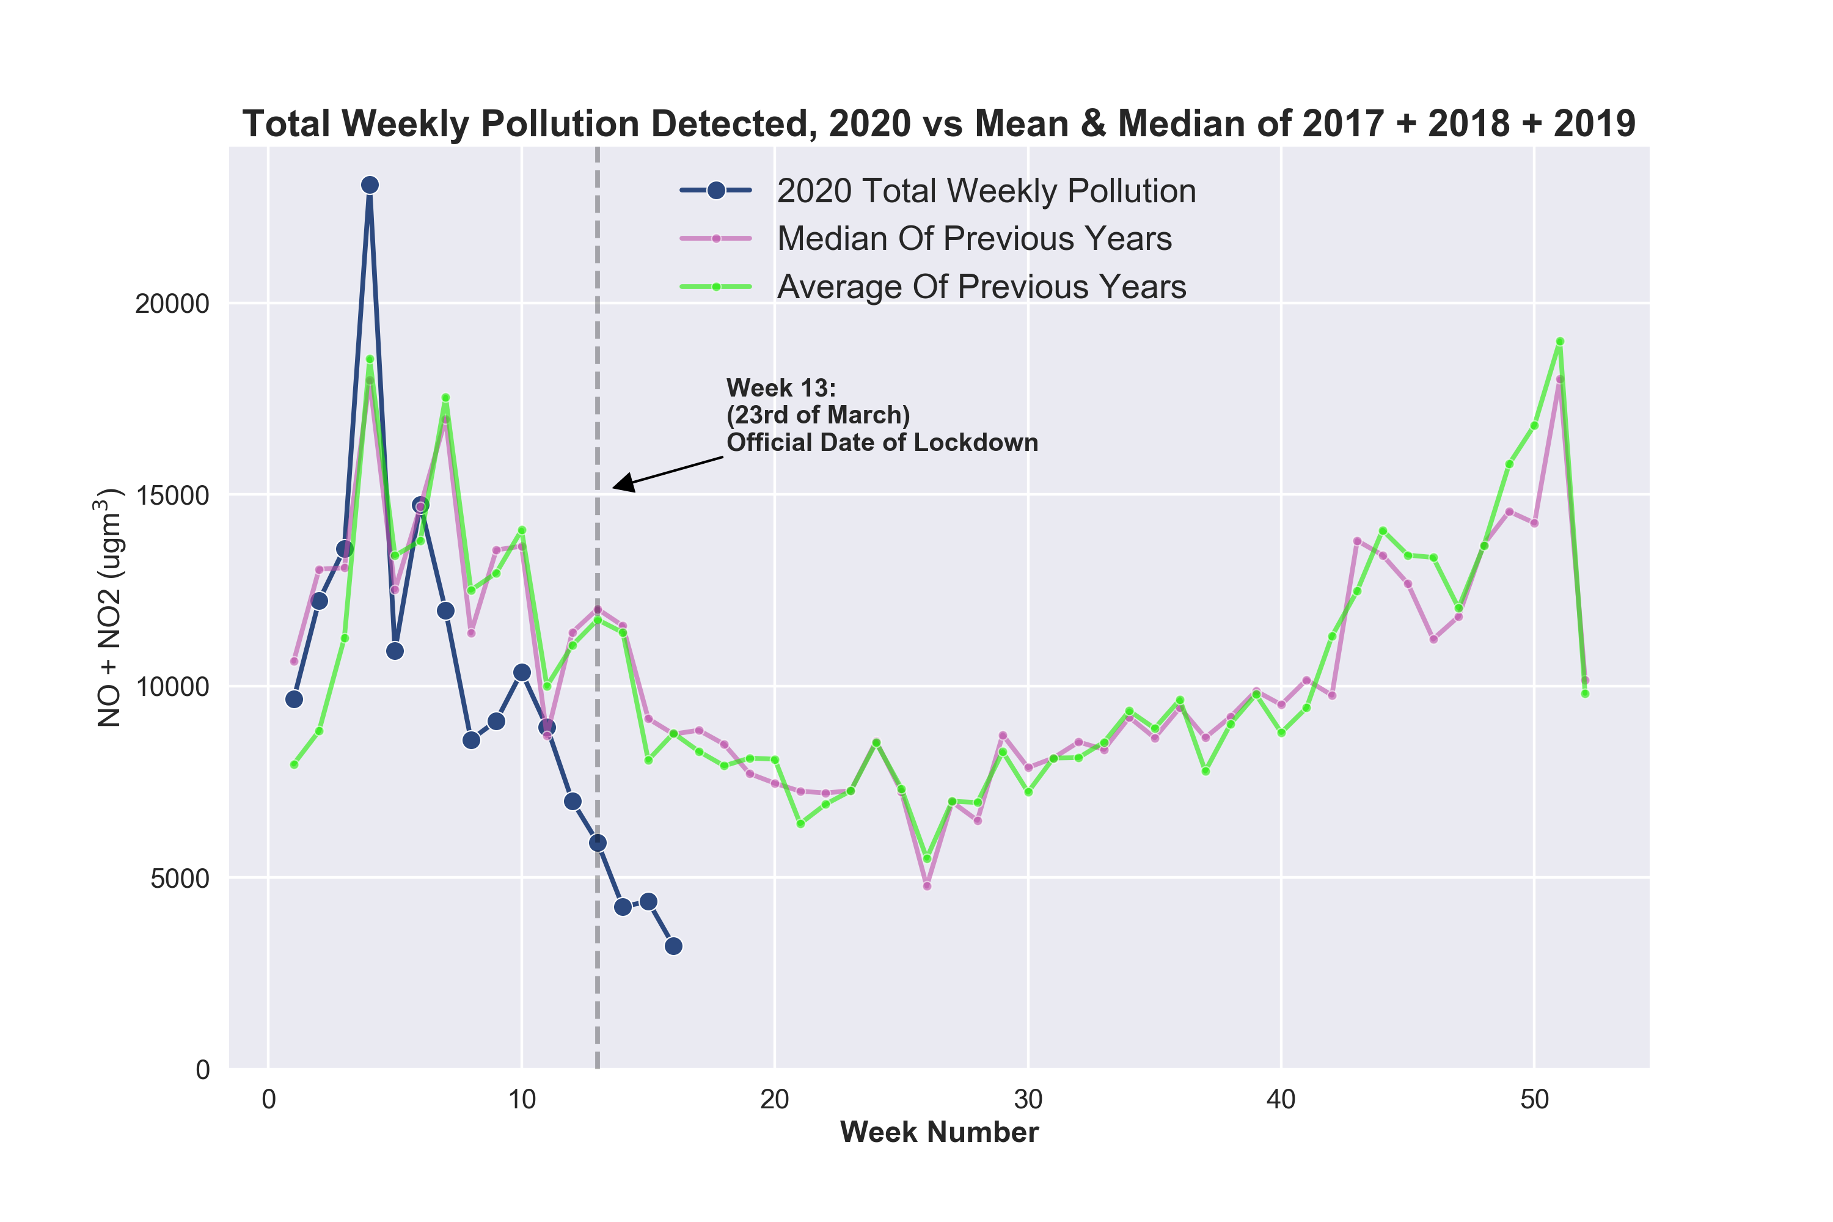

Slide 15
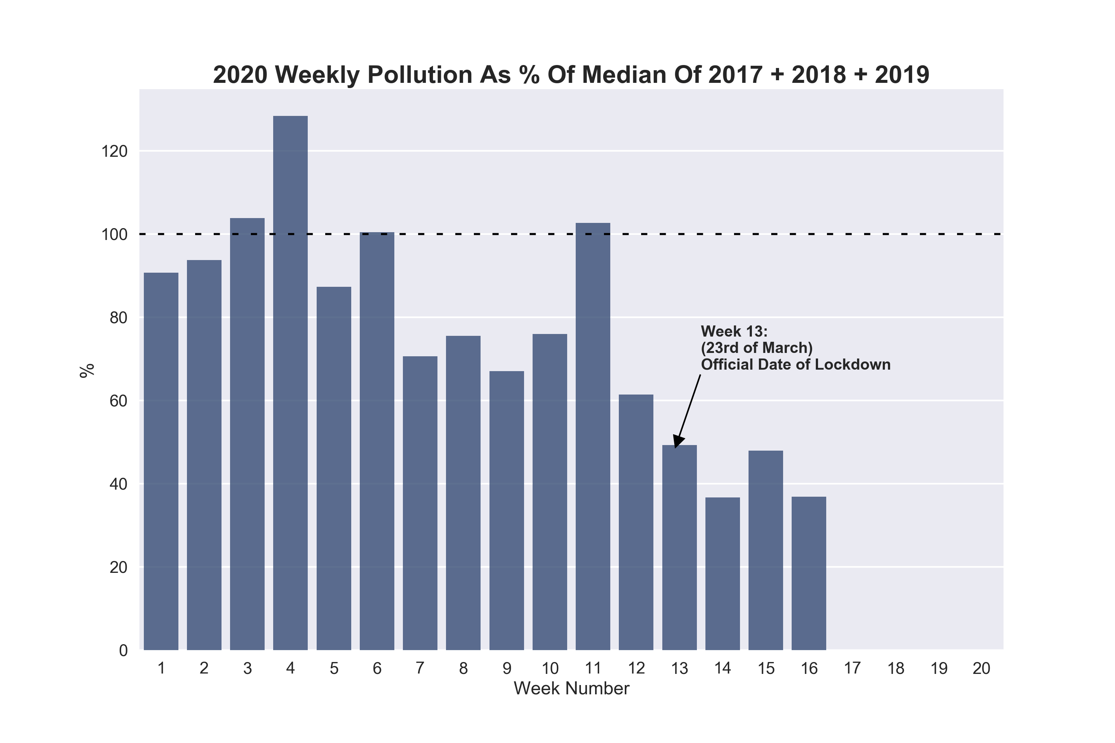
Similar to previous: asking “how is 2020 comparing to “normal” pollution levels measured in previous years?
Most weeks show pollution less than median (dashed line)

Slide 16
2020 monthly pollution vs previous years

Slide 17
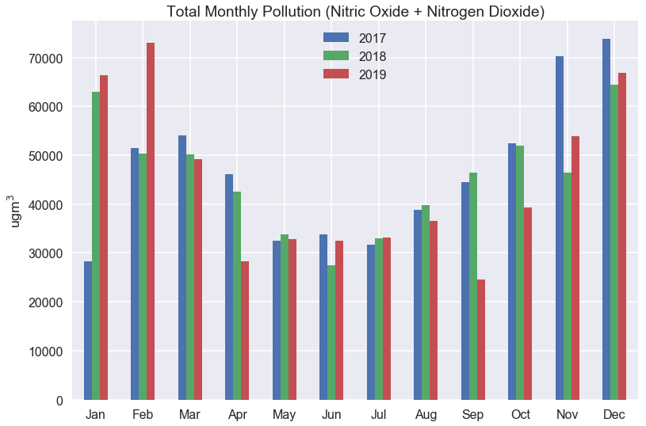
How each full month of 2020 compares to previous 3 years
Note Q1 and Q4 have high pollution, and pollution drops in Q2 and Q3

Slide 18
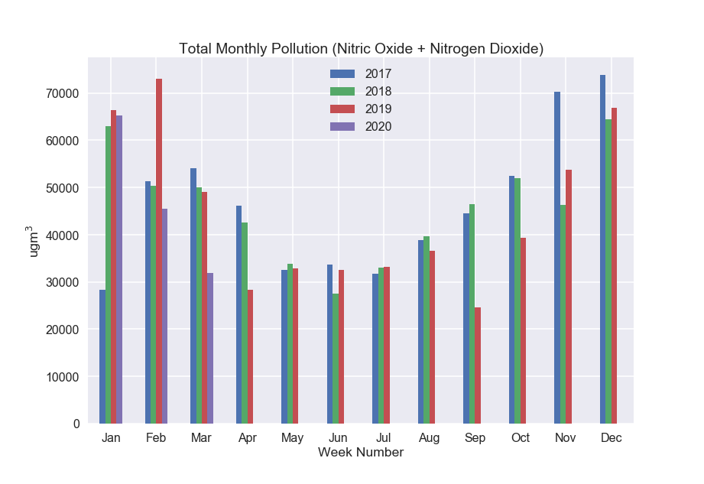
How each full month of 2020 compares to previous 3 years
Note Q1 and Q4 have high pollution, and pollution drops in Q2 and Q3

Slide 19
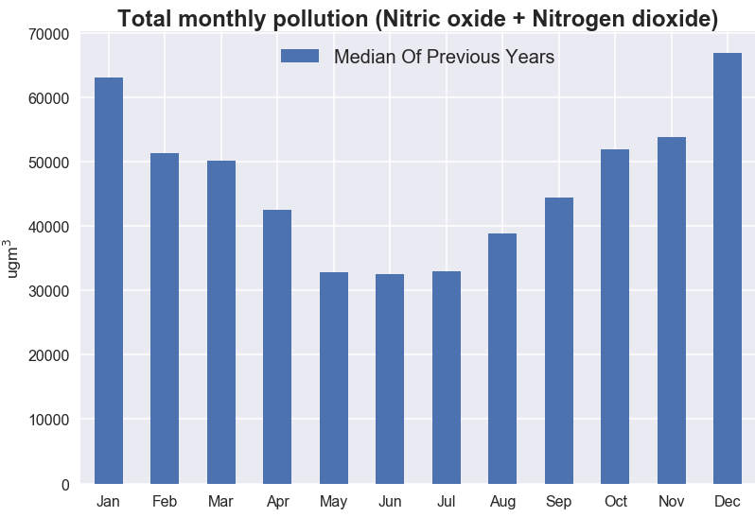

Slide 20
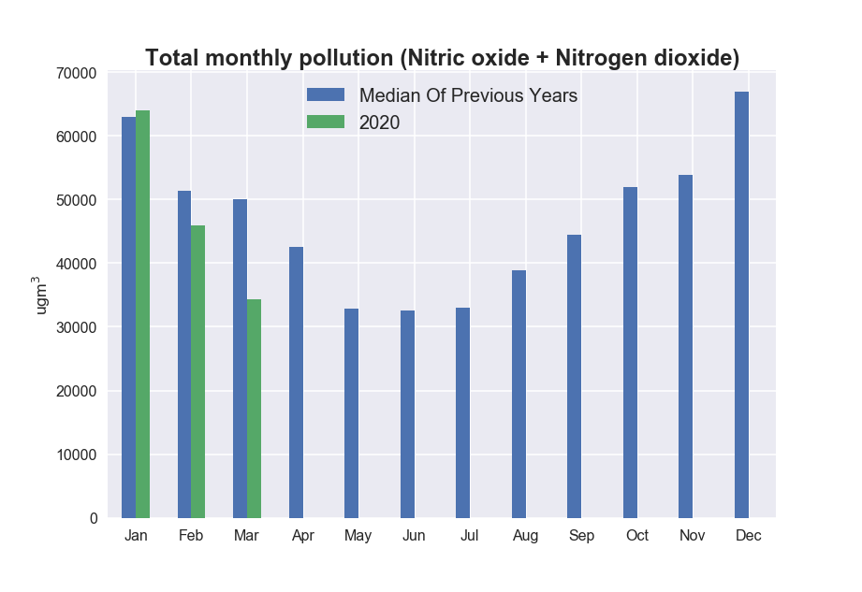

Slide 21
2020 hourly pollution since official lockdown

Slide 22
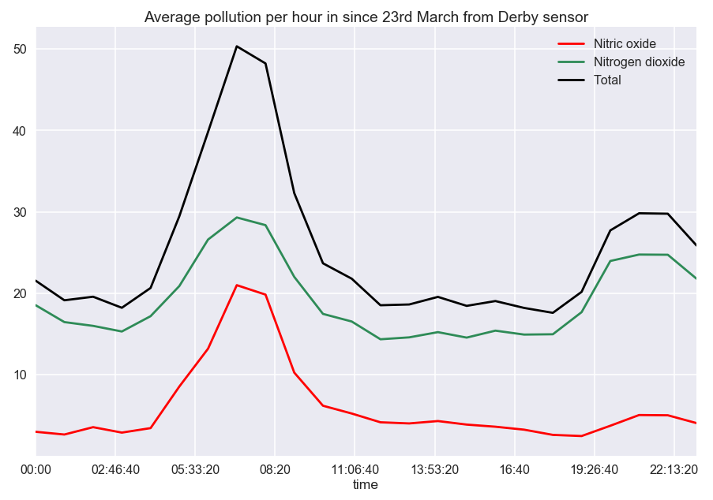

Slide 23
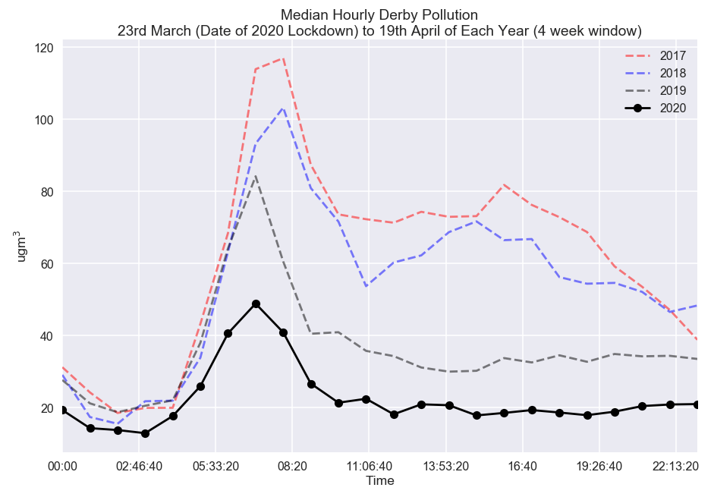
4 week period starting at 23rd of March (lockdown date) of each year compared

Slide 24
2020 pollution vs Apple Mobility data

Slide 25
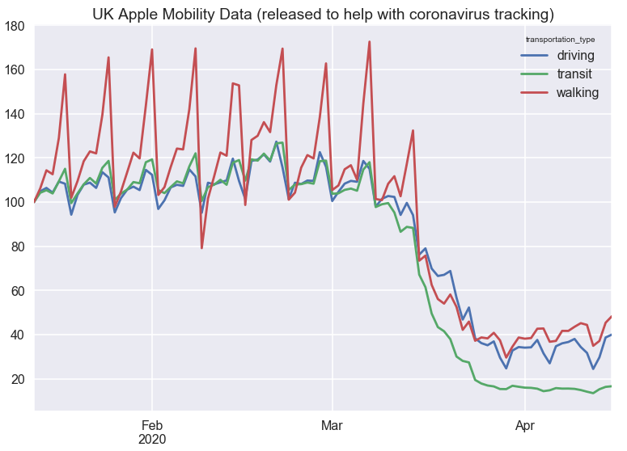

Slide 26
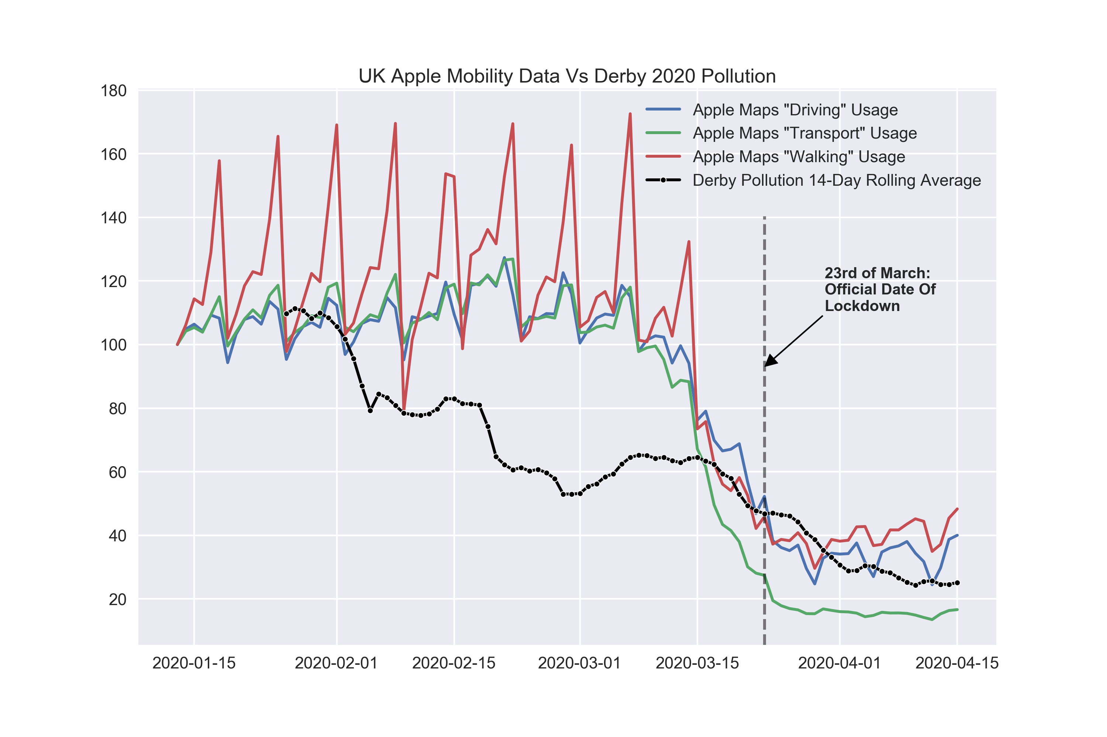
Daily Derby air pollution measured vs Apple Mobility data, which shows how much people are using Apple Maps
Derby air pollution dropped before official lockdown date and before Apple data (which is for whole of UK rather than specifically Derby) noted a change

